Slide 1
Machine Learning Model Readout
Xinran Chen, Tianyu Han, Ying Hong,
Siyu Shen, Shiyuan Xu
From Columbia MS Data Science

Slide 2
Agenda
Data Overview
Model Results
Next Steps

Slide 3
Data Overview
We are currently using 03-04, 05-06, 11-12,13-14 years of data.
Because our dataset contained too many useless features, we performed feature engineering this week.

Slide 4
Model Selection
Logistic Regression
XGboost
Random Forest

Slide 5
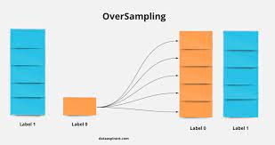
Oversampling Method
In many real-world classification problems, such as disease diagnosis, one class contains significantly fewer examples than the other. This imbalance can make machine learning models biased towards the majority class, as they tend to predict the majority class more frequently.
Oversampling is a technique aimed at addressing this class imbalance. It involves creating additional copies or synthetic examples of the minority class, increasing its representation in the dataset. This helps the machine learning model learn from the minority class more effectively.

Slide 6
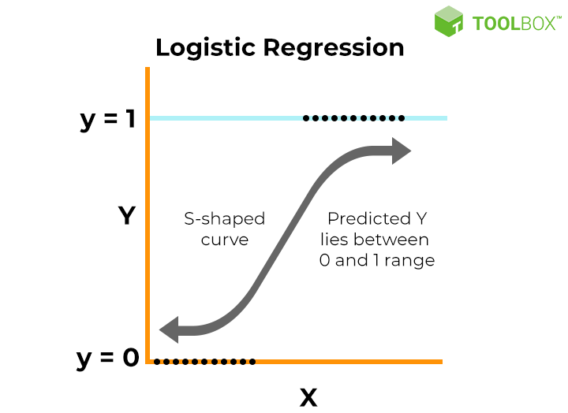
Model Intro- Logistic Regression
In logistic regression, the algorithm models the relationship between the input features and the probability of the binary outcome using the logistic function (also known as the sigmoid function). The output of this function is bounded between 0 and 1, which corresponds to the probability of belonging to the positive class. The logistic regression model computes a weighted sum of the input features and applies the logistic function to it.

Slide 7
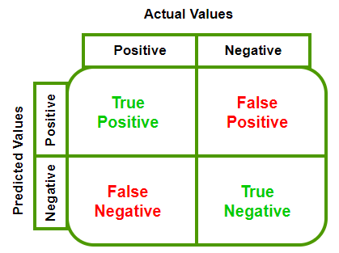
Confusion Matrix
Confusion Matrix provides a summary of the model's predictions by comparing them to the actual outcomes.
True Positives (TP): The number of correct positive predictions made by the model.
True Negatives (TN): The number of correct negative predictions made by the model.
False Positives (FP): The number of incorrect positive predictions made by the model (Type I error).
False Negatives (FN): The number of incorrect negative predictions made by the model (Type II error).

Slide 8
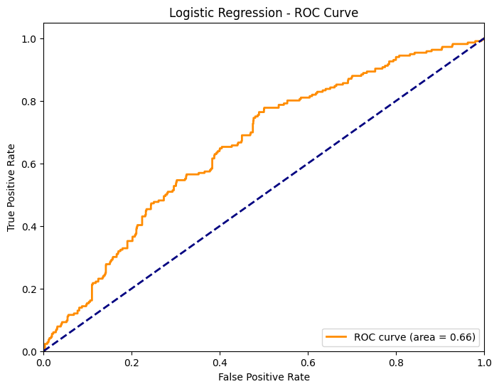
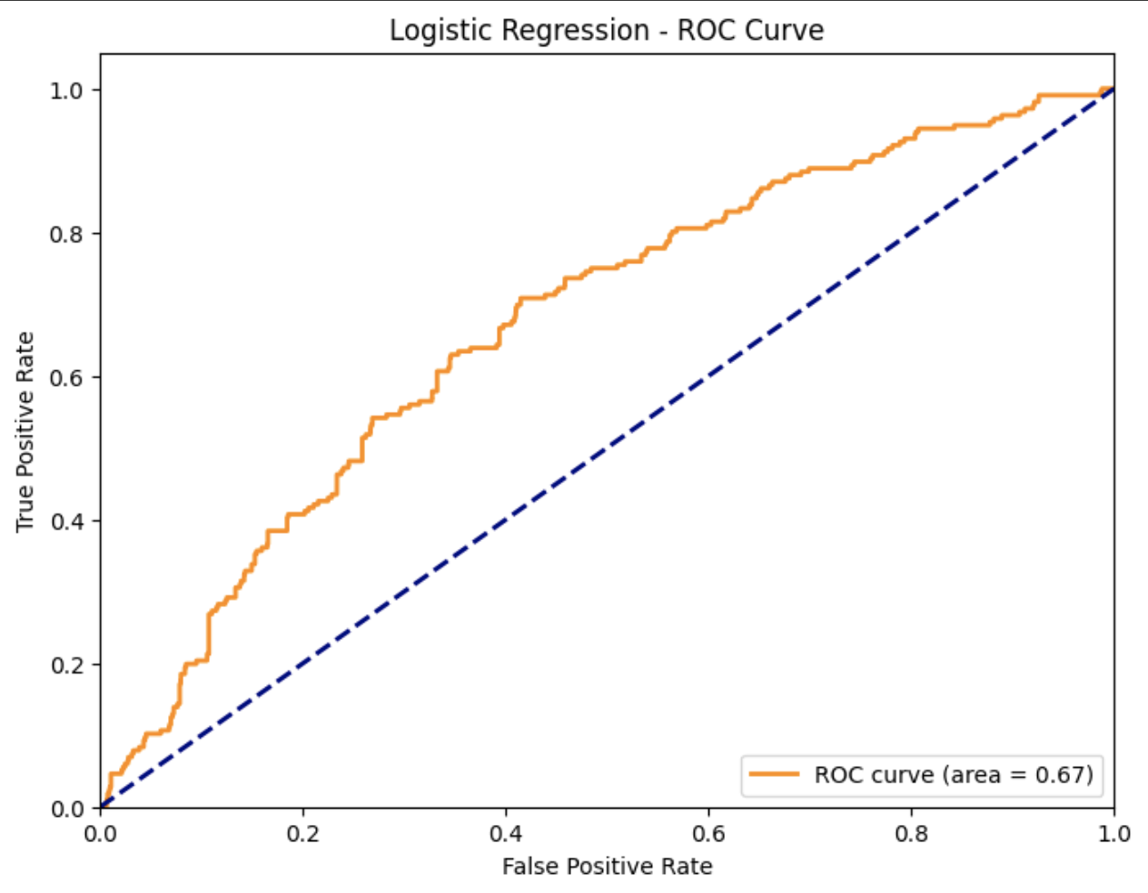
ROC Curve- Logistic Regression
New:
After performing feature engineering, our AUC from 0.67 to 0.66 shows no a big difference. It is considered a moderate level of performance.
Previous:

Slide 9
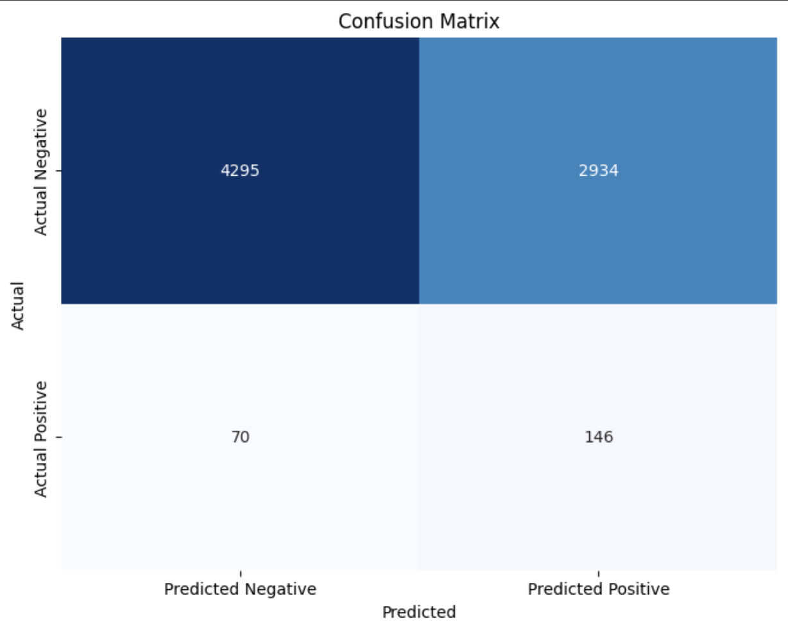
Confusion Matrix- Logistic Regression (PREVIOUS)
True Positives (TP): 146. The model correctly identified 146 instances as belonging to the positive class.
False Positives (FP): 2934. These are the cases where the model incorrectly predicted the positive class (1) when it should have been the negative class (0). This is a type I error, and the model made a total of 2934 of these mistakes.
False Negatives (FN): 70. These are the cases where the model incorrectly predicted the negative class (0) when it should have been the positive class (1). This is a type II error, and the model made a total of 70 of these mistakes.
True Negatives (TN): 4295. The model correctly identified 4295 instances as belonging to the negative class.

Slide 10

Confusion Matrix- Logistic Regression (NEW)
True Positives (TP): 141. The model correctly identified 141 instances as belonging to the positive class.
False Positives (FP): 3005. These are the cases where the model incorrectly predicted the positive class (1) when it should have been the negative class (0). This is a type I error, and the model made a total of 3005 of these mistakes.
False Negatives (FN): 75. These are the cases where the model incorrectly predicted the negative class (0) when it should have been the positive class (1). This is a type II error, and the model made a total of 75 of these mistakes.
True Negatives (TN): 4224. The model correctly identified 4224 instances as belonging to the negative class.

Slide 11
Feature Importance
Feature importance is a concept in machine learning that helps us understand the significance of different input variables (features) in making predictions or decisions within a model. It provides insights into which features contribute the most to the model's performance and how they influence the model's output.

Slide 12
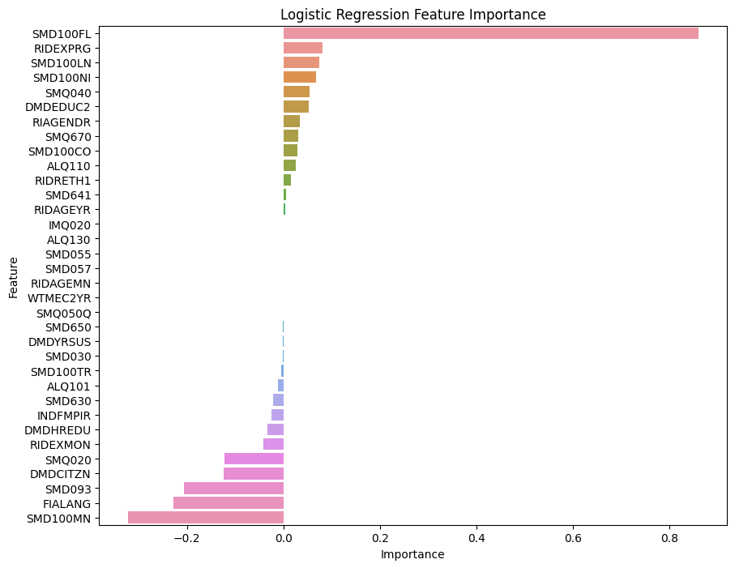
Feature Importance- Logistic regression
Selected features with high importance:
SMD100FL: Cigarette product filtered or non-filtered
RIDEXPRG: Pregnancy status at the time of MEC exam
DMDHREDU: What is the highest grade or level of school {you have/NON_SP HEAD has} received?
INDFMPIR: Poverty income ratio (PIR) - a ratio of family income to poverty threshold
SMD100MN - menthol indicator

Slide 13
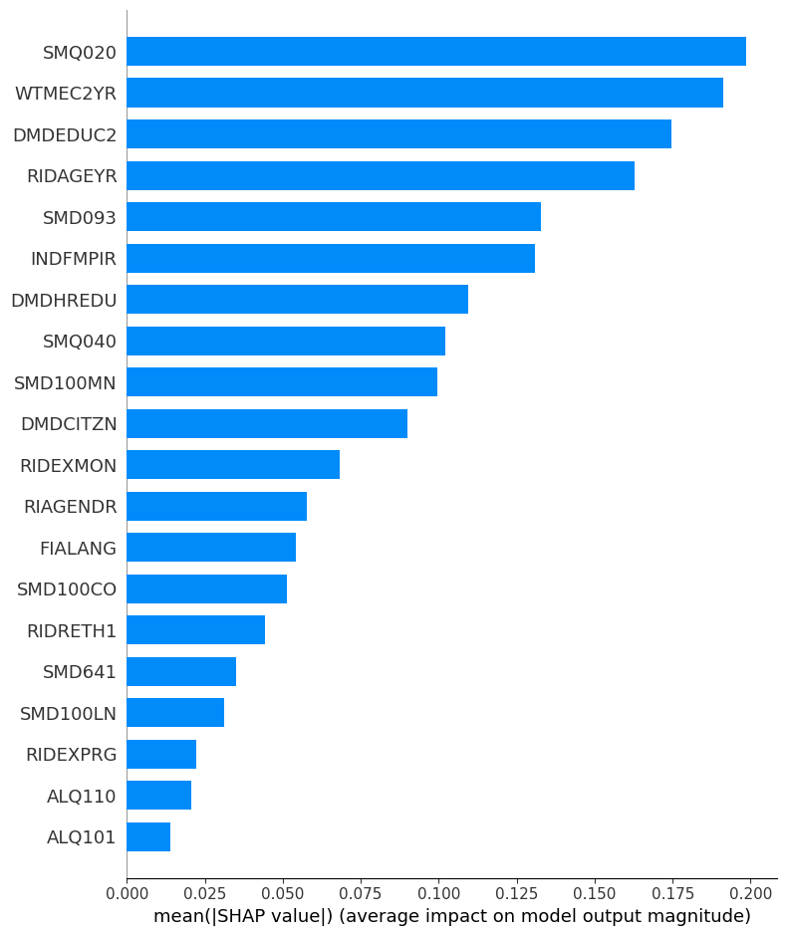

Slide 14
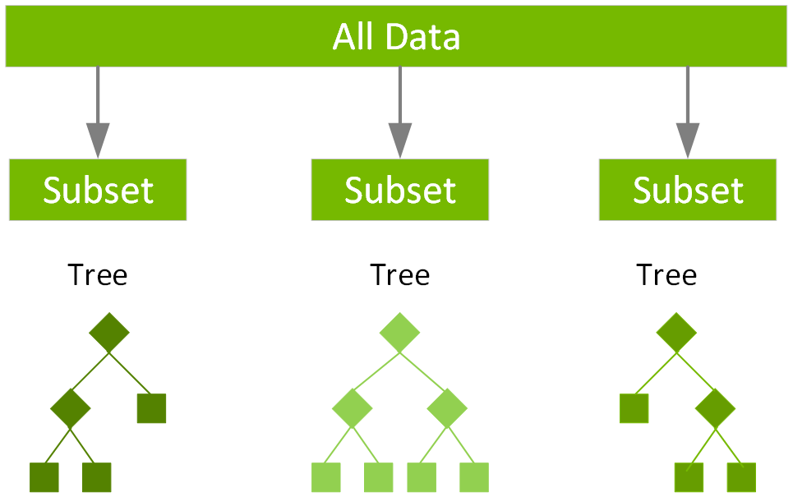
Model Intro - XGboost
XGBoost is an advanced implementation of the gradient boosting framework, which is an ensemble learning technique.
Gradient boosting combines the predictions of multiple weak learners (typically decision trees) to create a strong learner. It minimizes the residual errors of the previous models in a weighted and additive manner.

Slide 15
Model Performance Evaluation Metrics
Precision: measures the accuracy of positive predictions
Recall: measures the model's ability to correctly identify positive instances
F1-score: the harmonic mean of precision and recall.

Slide 16
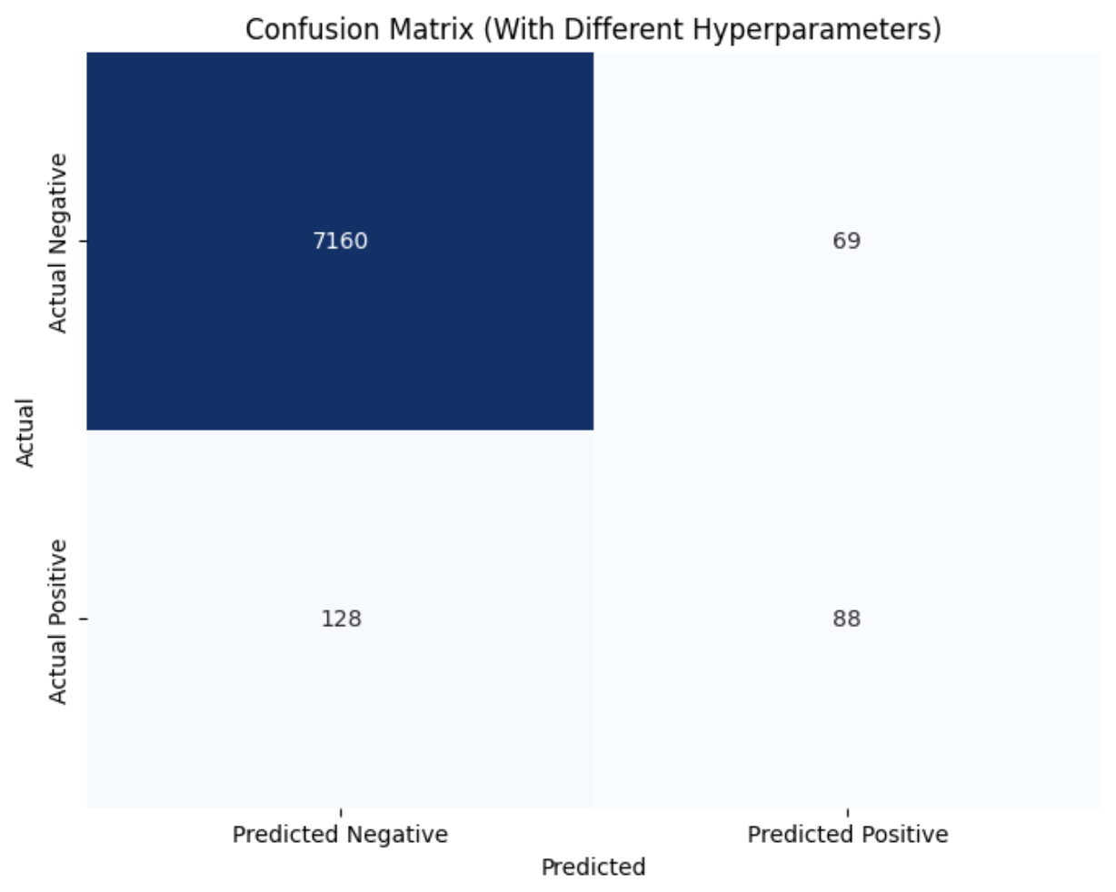
Confusion Matrix- Xgboost (PREVIOUS)
Precision is relatively low (56.05%), which means that when the model predicts the positive class, it has a significant number of false positives.
Recall is also somewhat low (40.74%), indicating that the model doesn't capture all of the positive class instances.
The F1 score provides a harmonic mean of precision and recall, and it's around 47.06%, which indicates a trade-off between precision and recall.

Slide 17

Confusion Matrix- Xgboost (NEW)
Precision is relatively low (36.36%), which means that when the model predicts the positive class, it has a significant number of false positives.
Recall is also somewhat low (40.74%), indicating that the model doesn't capture all of the positive class instances.
The F1 score provides a harmonic mean of precision and recall, and it's around 38.43%, which indicates a trade-off between precision and recall.

Slide 18
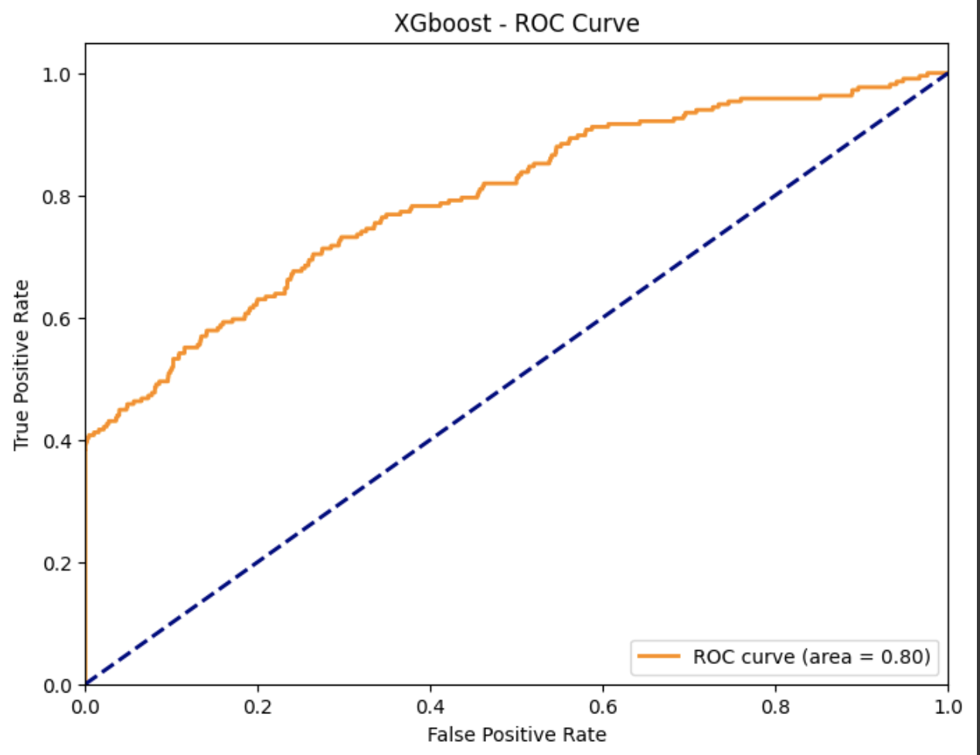
ROC Curve- XGboost (PREVIOUS)
The AUC of 0.80 suggests that, on average, the model is making good classification decisions.
However, the specific numbers in the confusion matrix (such as the number of False Positives and False Negatives) reveal that there are still some misclassifications.
The combination of the AUC and the confusion matrix indicates that the model is good at ranking instances but may still have room for improvement in precision and recall (compared to 0.52 from last time).

Slide 19
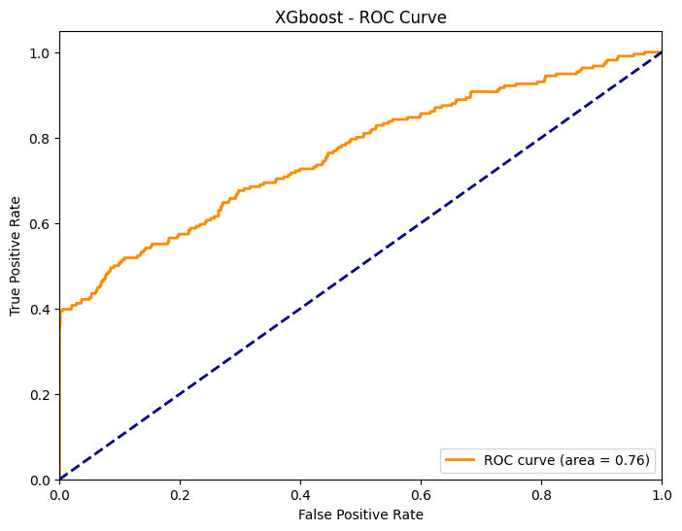
ROC Curve- XGboost (NEW)
After feature engineer, the AUC is getting a little bit lower, which is 0.76.
The original features might have artificially inflated the AUC. This can happen due to overfitting or data leakage, where the model is using information that would not be available at prediction time. Feature engineering that removes these problematic features could lead to a lower, but more honest, assessment of the model's predictive power.

Slide 20
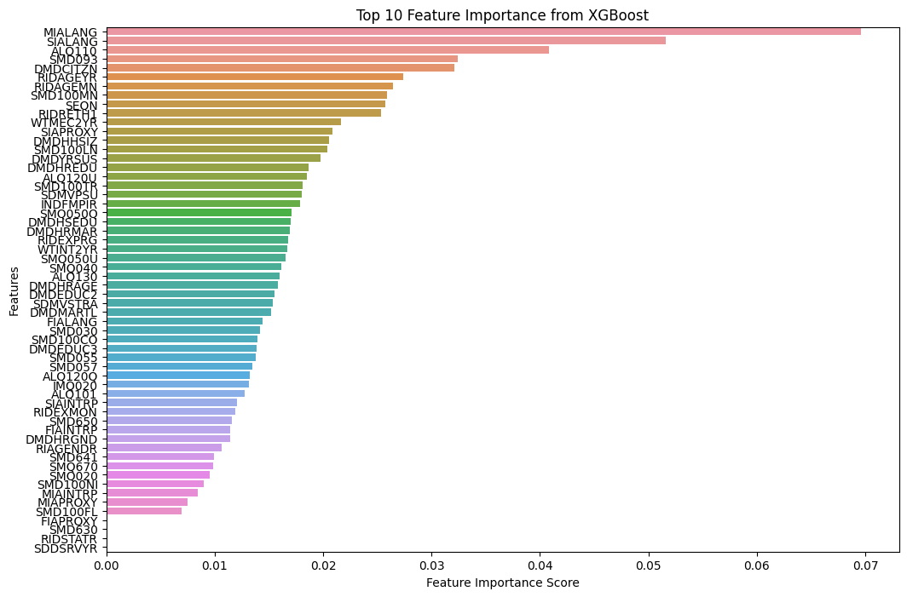
Feature Importance- Xgboost (PREVIOUS)
Selected features with high importance:
RIDAGEYR: Age at Screening
RIDRETH1: Race/Ethnicity
WIMEC2YR: Full Sample 2 Year MEC Exam Weight

Slide 21
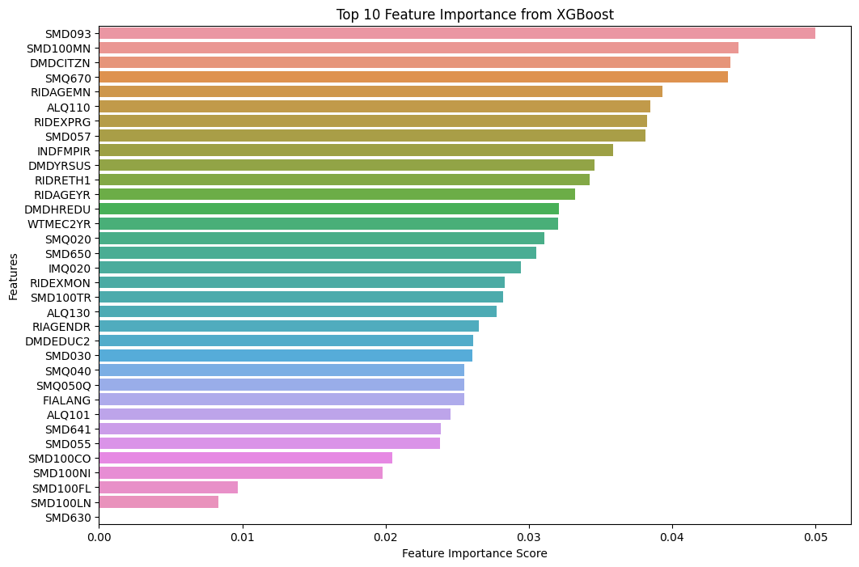
Feature Importance- Xgboost (NEW)
Selected features with high importance:
RIDAGEMN: Gender
ALQ110: Had at least 12 alcohol drinks/lifetime?
RIDEXPRG: Pregnancy status at the time of MEC exam.

Slide 22
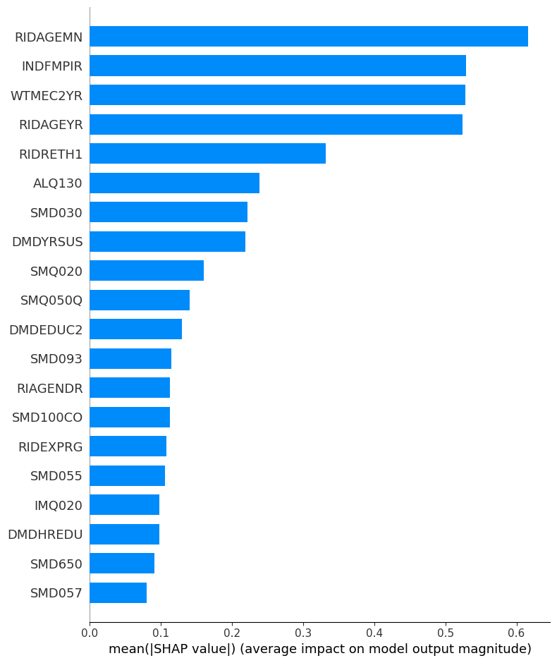

Slide 23
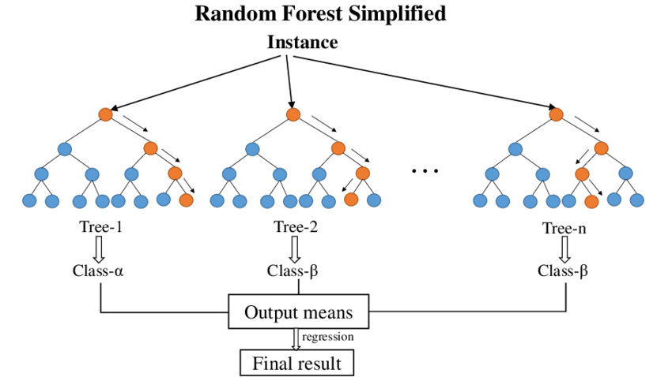
Model Intro - Random Forest
Random Forest operates by leveraging a collection of decision-making models known as decision trees, each of which focuses on a different aspect of the problem. These trees are constructed in a slightly random manner, introducing diversity and reducing the risk of overfitting, ultimately leading to more reliable results.

Slide 24
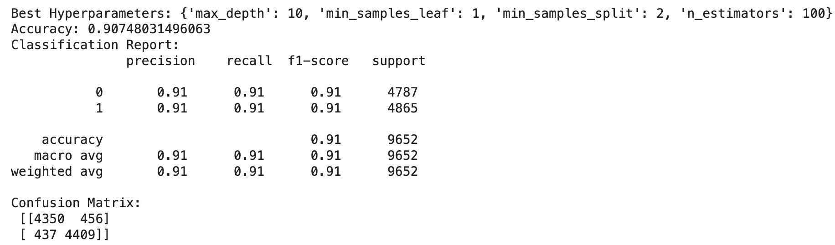
Model Results - Random Forest
The Random Forest classifier, after hyperparameter tuning and oversampling, performs exceptionally well on the test data. It achieves almost perfect accuracy, precision, recall, and F1-scores for both classes.

Slide 25
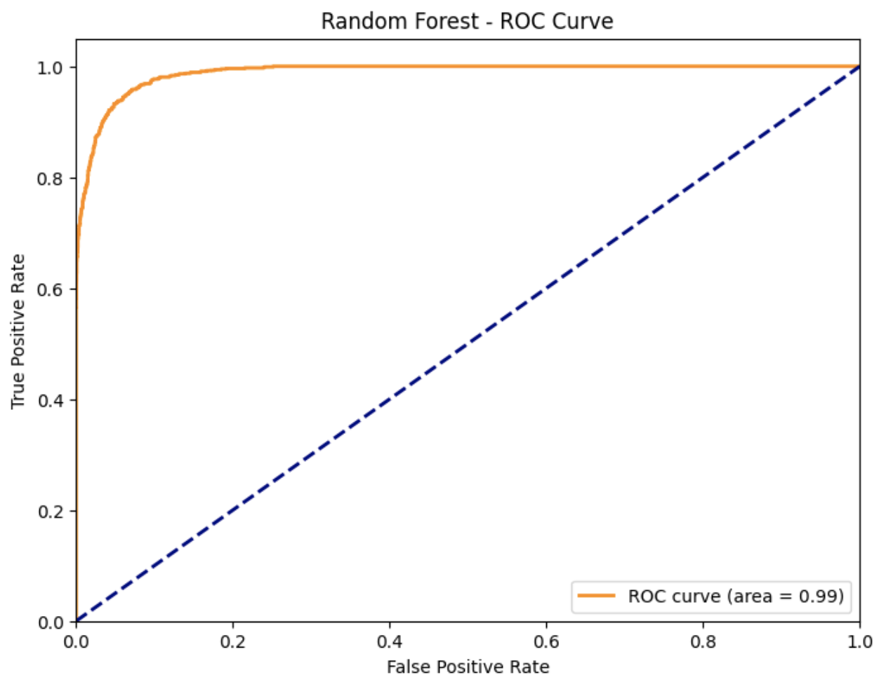
ROC Curve - Random Forest (PREVIOUS)
The Random Forest model demonstrates outstanding performance. It has high accuracy, precision, recall, and specificity, making it an impressive classifier with minimal false positives and false negatives. This level of performance is considered as highly reliable and effective for various classification tasks.

Slide 26
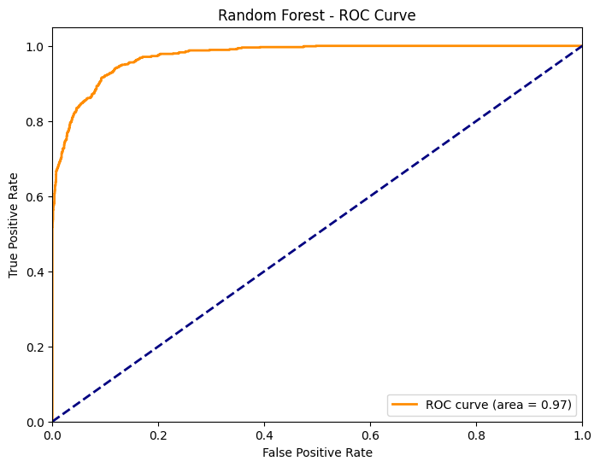
ROC Curve - Random Forest (NEW)
Following feature engineering, the random forest model may not exhibit the same level of perfection as previously observed (from 0.99 to 0.97); however, it continues to perform robustly.

Slide 27
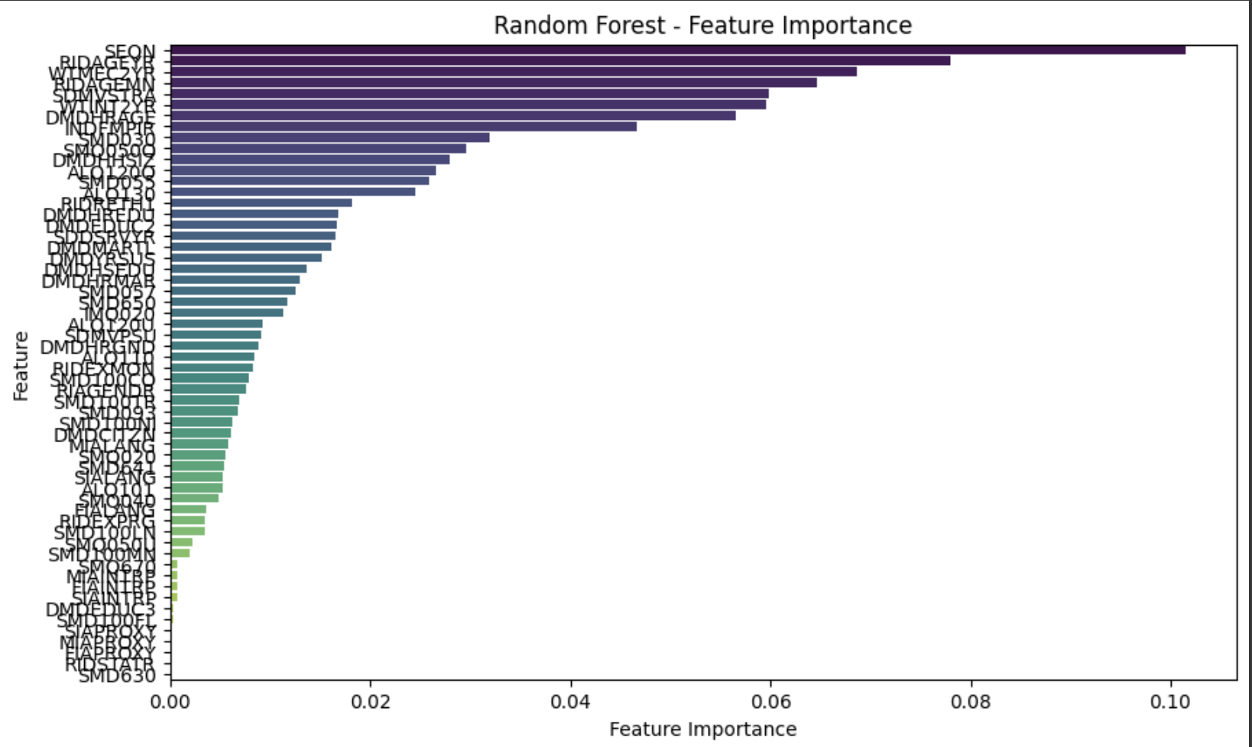
Feature Importance - Random Forest (PREVIOUS)
Selected features with high importance:
RIDAGEYR：Age at Screening
WIMEC2YR: Full Sample 2 Year MEC Exam Weight
SDMVSIRA: Masked Variance Unit Pseudo-Stratum variable for variance estimation
INDFMPIR: Family PIR, Poverty income ratio (PIR) - a ratio of family income to poverty threshold
SMD030: Age started smoking cigarets regularly

Slide 28
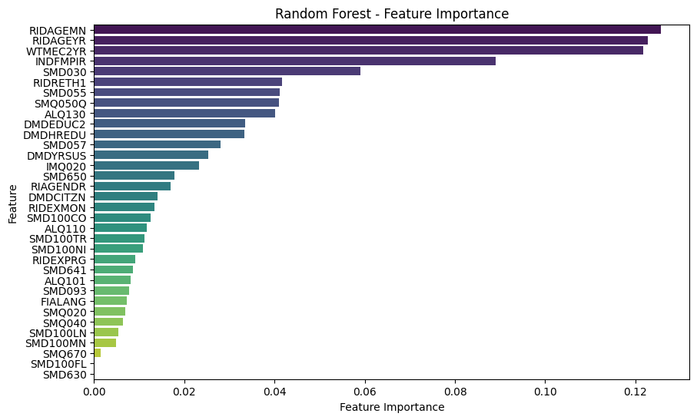
Feature Importance - Random Forest (NEW)
Selected features with high importance:
RIDAGEMN / RIDAGEYR：Age at Screening
WIMEC2YR: Full Sample 2 Year MEC Exam Weight
INDFMPIR: Family PIR, Poverty income ratio (PIR) - a ratio of family income to poverty threshold
SMD030: Age started smoking cigarets regularly

Slide 29
Next Steps

